Slide 1
Media Briefing
कर्मयोगी अभियान
Mission Karmayogi - National Programme for Civil Services Capacity Building
Integrated Government Online Platform-iGOT Karmayogi
2nd September 2020

Slide 2
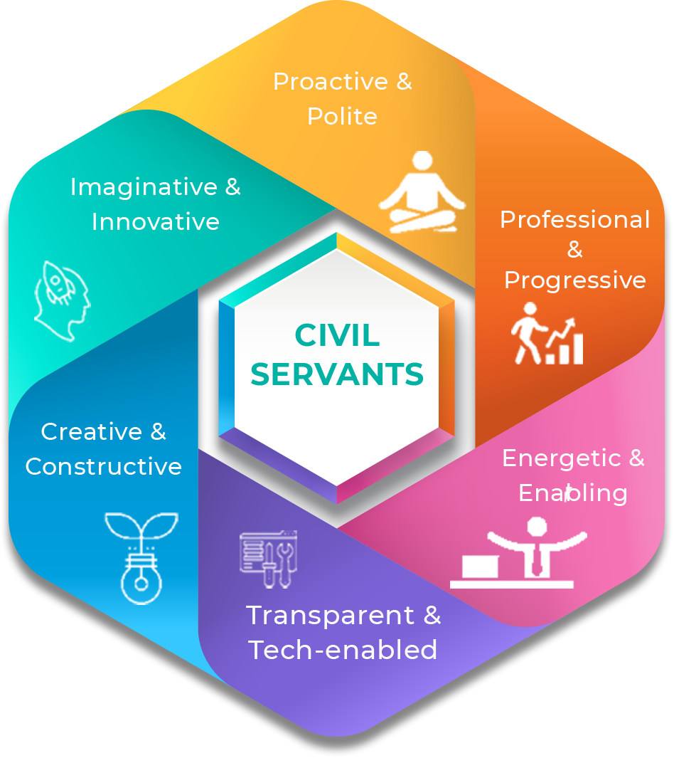
Karmayogi for the Nation

Slide 3
Existing Impediments
1
2
3
Diverse and fragmented training landscape
Evolution of silos at Department level preventing shared understanding of India’s development aspirations
Inconsistencies in training priorities, competency & pedagogy
4
5
6
Lack of common platform and barriers to exchange of knowledge
Lack of lifelong & continuous learning environment
Redundancy & duplication of efforts

Slide 4
Mission Karmayogi
1
New National Architecture for Civil Services Capacity Building
2
Comprehensive reform of the capacity building apparatus at individual, institutional and process levels for efficient public service delivery.
3
PM led HR Council to approve and monitor Civil Service Capacity Building Plans
4
Capacity Building Commission to harmonize training standards, create shared faculty and resources, and have supervisory role over all Central Training Institutions.
5
Wholly owned SPV to own and operate the online learning platform and facilitate world-class learning content market-place.

Slide 5
Mission Karmayogi – Build Future Ready Civil Service - with right Attitude, Skills and Knowledge, aligned to the Vision of New India
Ease of Living
Competencies to ensure on time and effective Public Service Delivery for Citizens
Competency led Capacity Building
India’s own Civil Service Competency Framework
Shared understanding of India’s developmental aspirations, National Programmes & Priorities
Goals Driven
Domain and Functional Competencies
Ease of Doing Business
Creating policies and delivering services conducive to economic growth
Behavioral Competencies
Accountability & Transparency
through Objective Evaluations
Scale of Impact
A Global Exemplar - ~30 Lac users in year 1 & ~2 Cr in long run
The Government Official
Citizen Centricity
Citizen Centricity (respectful interactions, problem solving competencies) Subject Matter Expertise and Attitudinal change

Slide 6
Mission Karmayogi – Key Programme Components
Shift from Rule to Role
Digital Platform, made in India, offering services around Learning and Career Management
Competency Framework - FRAC
iGOT Karmayogi
Enabling policies to upgrade & harmonize capacity building
Credible and Autonomous Institutional Framework
Policy Framework
Institutional Structure
Monitoring & Evaluation
HR Management
Continuous performance analysis, data driven goal-setting and real time monitoring
Strategic HR management to deliver the right competencies – Behavioral, Domain & Functional

Slide 7
Mission Karmayogi – Institutional Structure
Governance
Performance
Accountability
PM’s HR Council (PMHRC) - Apex Body to provide strategic direction to capacity building reforms
Prime Minister’s HR Council
Cabinet Secretariat Coordination Unit
Capacity Building Commission to harmonize training standards, create shared faculty & resources & supervise Central Training Institutions
Capacity Building Commission
Special Purpose Vehicle
(100% govt. owned)
Cabinet Secretariat Coordination Unit - to monitor progress and execution and oversee plans
SPV - to own and operate the online platform - iGOT Karmayogi and facilitate world class learning
Mission Karmayogi - National Programme for Civil Services Capacity Building
Outlay of Rs 510 Cr. Over 5 years
Annual Subscription @ Rs 431 per civil servant charged by SPV

Slide 8
The Prime Minister’s HR Council is at the apex
Structure of the PM’s HR Council
Mandate/ Charter of the HR Council
Chairperson: Hon’ble Prime Minister
Political Leadership: Select Union Ministers, State Chief Ministers
Thought Leadership: Eminent national and global Academicians, thought leaders, Industry leaders
Civil Service Leadership
Apex body driving & providing strategic direction to the Programme
Approves & Monitors Civil Service Capacity Building plan
Reviews reports submitted by Capacity Building Commission
Prime Minister’s HR Council

Slide 9
The Capacity Building Commission – Key Functionalities
Mandate/ Charter of the Commission
Drive standardization, harmonization and shared understanding of Capacity Building activities
Create shared learning resources, including internal and external faculty and resource centers.
Define templates for Annual Capacity Building Plan. Assist PM HR Council in approval of the Plan
Functional supervision over all Central Training Institutions
Set norms for common mid-career training programs
Analyse learning related data from iGOT-Karmayogi
Prepare the Annual State of Civil Service Report

Slide 10
Special Purpose Vehicle – Structure & Function
Structure of the Special Purpose Vehicle (SPV)
Key Functions of the SPV
Legal: Company under Section 8 (of Companies Act) with 100% Government ownership
Board of Directors: Representing all participating entities of the Programme
Own and operate the online Platform, iGOT Karmayogi on behalf of Government
Operationalize a robust content ecosystem
Manage assessment & certification eco-system
Marketing, Outreach & Change Mgmt.
Manage governance of data & its analysis and make them available to authorities
Curate & deliver programmes for capacity building of Civil Servants in other countries
Revenue Model of SPV
Self sustaining: Annual Subscription fee of INR 431 per employee

Slide 11
Monitoring & Evaluation Framework
Monitoring and Evaluation of Mission Karmayogi
Prime Minister’s Dashboard
Capacity Building Plan
Annual State of Civil Services Report
Independent Audits
Real-time reporting of Capacity Building KPIs with Annual Score Cards and Rankings for Departments
Goal Setting - Annual Plans submitted by each Department aligned to National ambitions
Consolidated Performance of Civil Services as a whole in a year with focus on achievements & contribution to National Progress
Third Party Audit of Programme, in addition to regular Audit and Quality Assurance by Capacity Building Commission

Slide 12
Democratized Civil Service - Silo-less Performance
SELF ACTUALIZATION
Self driven; building competencies to achieve one’s full potential
ESTEEM AND RECOGNITION
Knowledge driven; building competencies to become leaders and subject matter experts
PERSONAL GROWTH
Purpose driven; building competencies to achieve personal aspirations
PROFESSIONAL GROWTH
Growth driven; building competencies to enable career progression and deliver different roles
PROFESSIONAL DELIVERY
Performance driven; building competencies to deliver one’s roles better

Slide 13
Focus on Citizen Centricity and Governance Reforms
Being respectful and sensitive to citizen
Competence for high quality of service delivery
Closing the citizen feedback loop
Integrated & seamless delivery
Citizen at Centre
Capacity at the cutting edge
Delivery based on roles

Slide 14
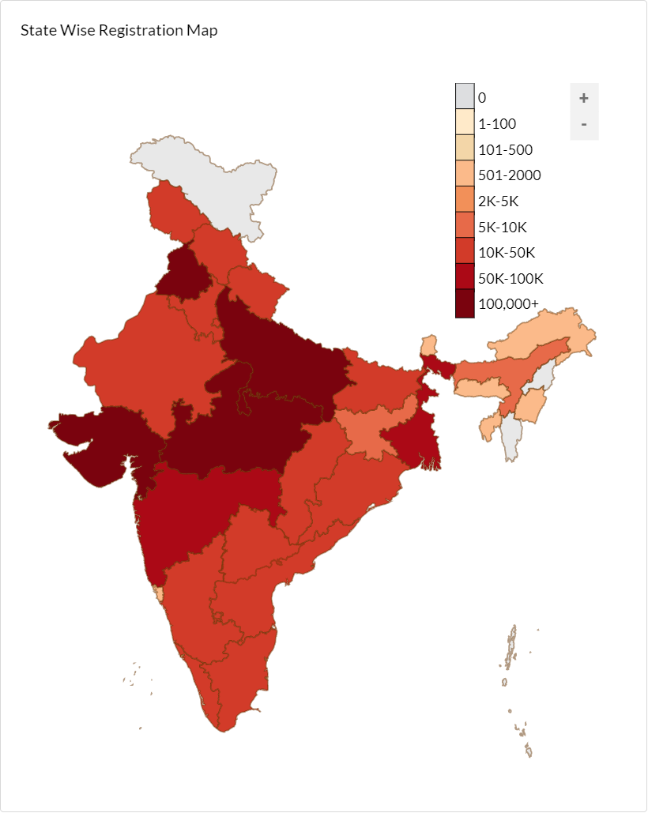
iGOT Pilot Model has trained COVID Warriors and led India’s fight against COVID
12,73,276 Registered Users
17,66,793 Course Completion
14,06,564 Certificates Issued
Supporting content delivery in 12 Languages
Courses provided to Diverse Audience
Through Multiple Channels of Delivery
Doctors
Nurses
NCC Cadets, NSS Volunteers
Desktop Portal
Offline access – iGOT TV
Allied & Healthcare
ASHA & Anganwadi volunteers
Mobile Browser
Technicians
Stats as on 24 July 2020

Slide 15
Thank You

